Slide 1

c¹
f¹
a²
c²
a¹
d²
f²
d¹

Slide 2










$$\left|θ_{2}^{t} −θ_{1}^{t} \right|$$
$$\left|θ_{2}^{t+1} −θ_{1}^{t+1} \right|$$
$$s_{2}^{t}$$
$$\left|θ_{3}^{t} −θ_{2}^{t} \right|$$
$$s_{2}^{t+1}$$
$$\left|θ_{3}^{t+1} −θ_{2}^{t+1} \right|$$
$$s_{1}^{t}$$
$$s_{3}^{t}$$
$$s_{1}^{t+1}$$
$$s_{3}^{t+1}$$

Slide 3
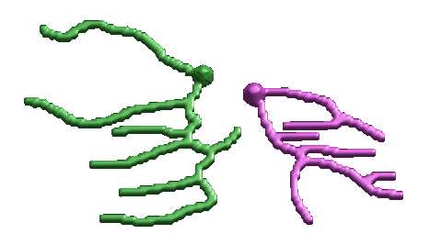










Y
X
$$\left|θ_{2}^{t} −θ_{1}^{t} \right|$$
$$\left|θ_{2}^{t+1} −θ_{1}^{t+1} \right|$$
$$s_{2}^{t}$$
$$\left|θ_{3}^{t} −θ_{2}^{t} \right|$$
$$s_{2}^{t+1}$$
$$\left|θ_{3}^{t+1} −θ_{2}^{t+1} \right|$$
Z
$$s_{1}^{t}$$
$$s_{3}^{t}$$
$$s_{1}^{t+1}$$
$$s_{3}^{t+1}$$
X

Slide 4








Y
X
$$\left|θ_{2}^{t} −θ_{1}^{t} \right|$$
$$\left|θ_{2}^{t+1} −θ_{1}^{t+1} \right|$$
$$s_{2}^{t}$$
$$\left|θ_{3}^{t} −θ_{2}^{t} \right|$$
$$s_{2}^{t+1}$$
$$\left|θ_{3}^{t+1} −θ_{2}^{t+1} \right|$$
Z
$$s_{1}^{t}$$
$$s_{3}^{t}$$
$$s_{1}^{t+1}$$
$$s_{3}^{t+1}$$
X

Slide 5
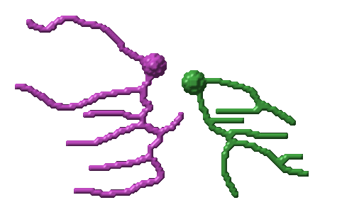


$R(s_{N}^{t})$
Neuron Pair
s₁
s₂
s_{2N}
N
$L(s_{N+1}^{t})$
N

Slide 6





Y
X
$$\left|θ_{2}^{t} −θ_{1}^{t} \right|$$
$$s_{2}^{t}$$
$$\left|θ_{3}^{t} −θ_{2}^{t} \right|$$
Z
$$s_{1}^{t}$$
$$s_{3}^{t}$$
X

Slide 7
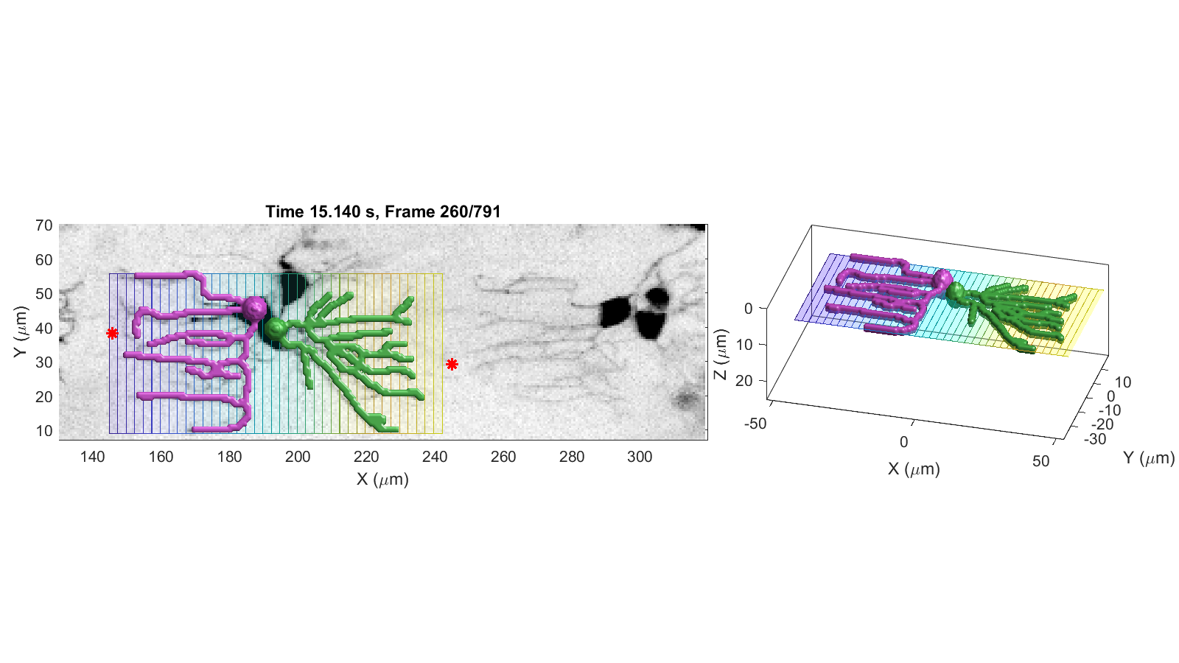
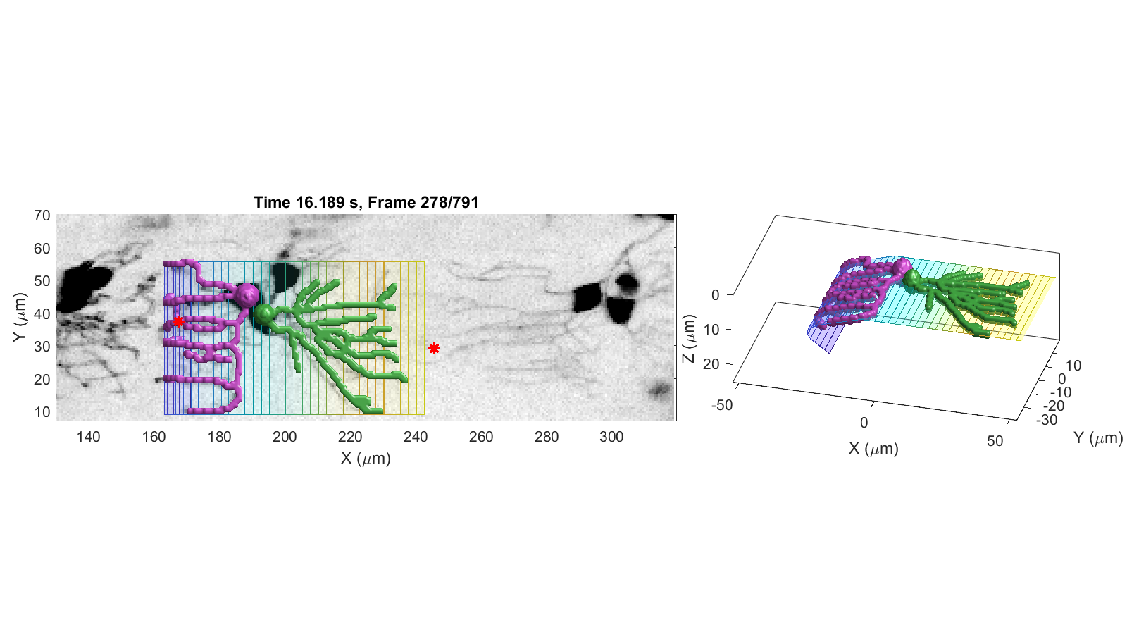
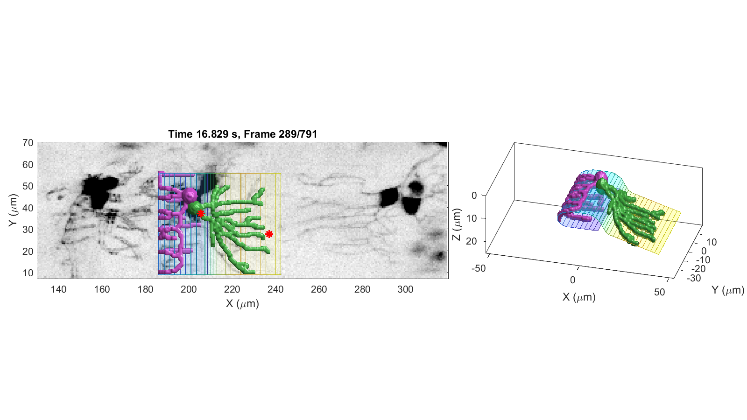
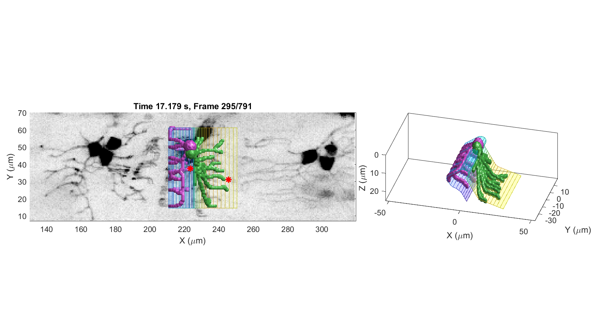
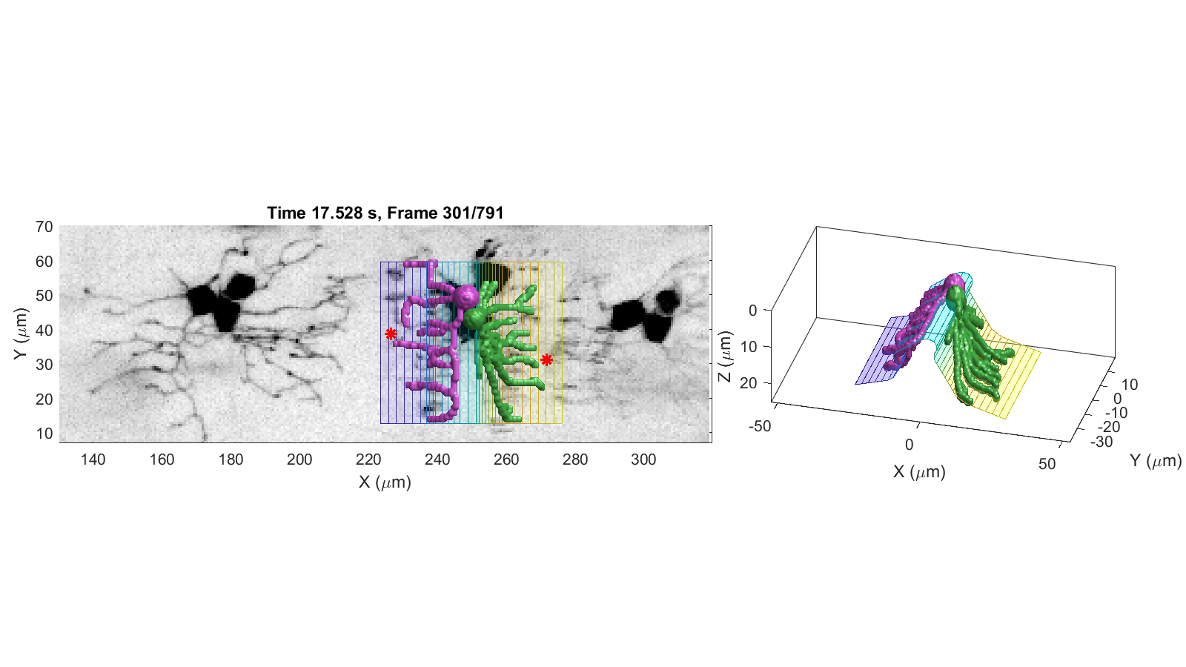
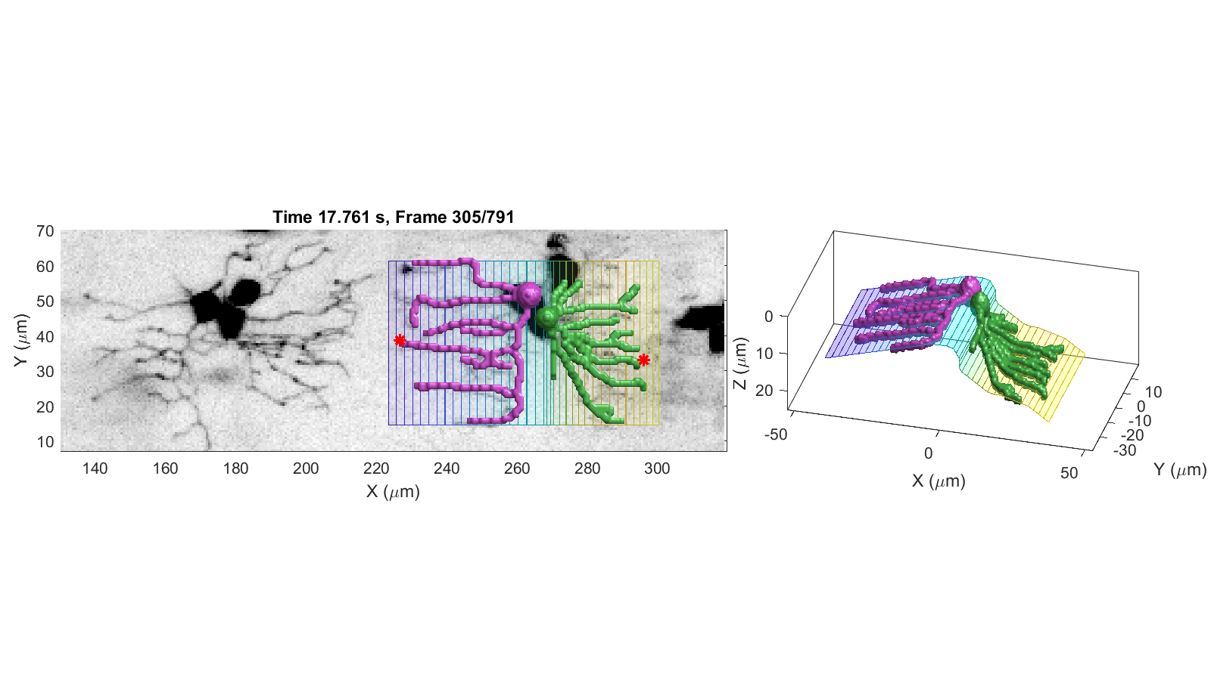
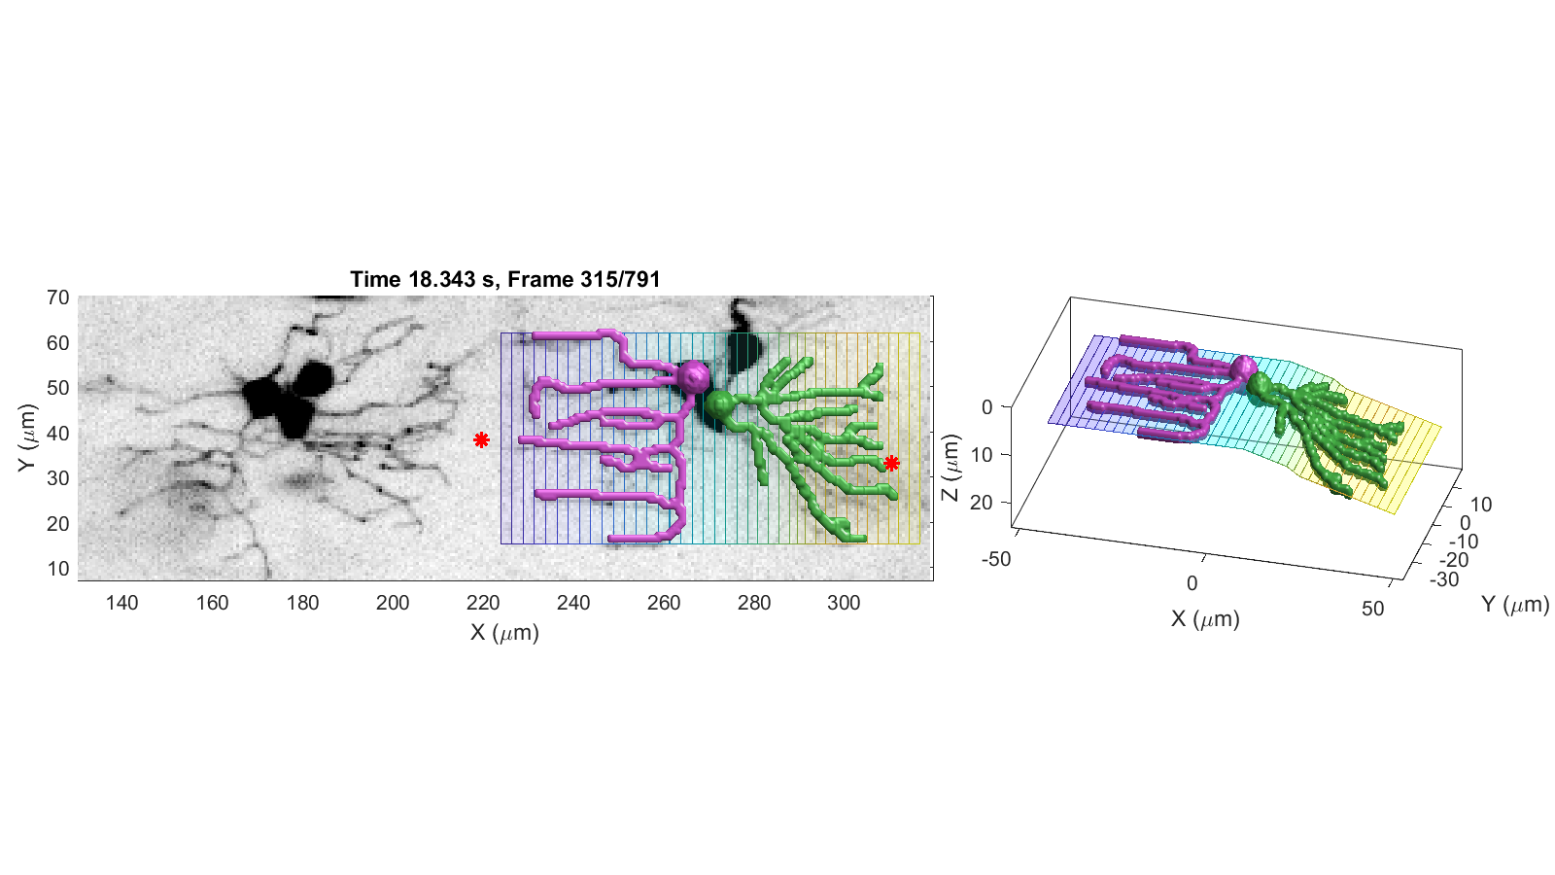
15.14s
15.14s
16.19s
16.19s
16.83s
16.83s
17.18s
17.18s
17.53s
17.53s
17.76s
17.76s
17.99s
18.34s

